Slide 1
ACMA 231
SQL
Nested Queries and WITH Statements

Slide 2
Subqueries
Oftentimes, you will need more than one table in more than one step to get what you need.
What if you want to accomplish this without creating multiple tables in the database? Or…what if you want to accomplish this without creating mid-step tables?
For example:
CREATE TABLE Average_Age AS
SELECT
AVG(AGE) as AvAge FROM SCHEMA.TABLE;
CREATE TABLE Greater_than_Average AS SELECT
NAMES
FROM SCHEMA.TABLE nm, Average_Age aa WHERE nm.AGE > aa.AvAge;

Slide 3
Subquery
Subqueries
SQL query nested in a larger query
  Can be added to the WHERE, SELECT, and FROM clauses
  Can be run on their own to produce results, often single or multiple values
Queries with Subqueries execute from the inner most query outward
Multiple nested Subqueries are possible
SELECT NAMES
FROM SCHEMA.TABLE
WHERE AGE > (SELECT AVG(AGE) FROM SCHEMA.TABLE);
Outer Query
Inner Query

Slide 4
Practice
Subqueries
Using a subquery, return all rows from the iris table with IDs the same as the color_IDs associated with Mercedes found in the mtcars table. HINT: the wildcard character in SQL is %.

Slide 5
Practice - Answer
Subqueries
Using a subquery, return all rows from the iris table with IDs the same as the color_IDs associated with Mercedes found in the mtcars table. HINT: the wildcard character in SQL is %.
SELECT * FROM IRIS
WHERE ID IN (SELECT COLOR_ID FROM MTCARS
WHERE NAME LIKE ‘Merc%’)

Slide 6
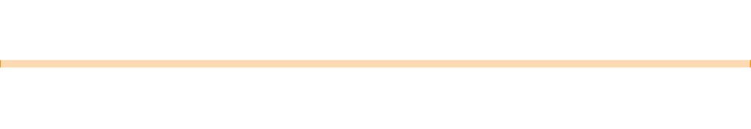

Subquery – Scoping Considerations
Subqueries
Be mindful of the order of operations; the scope of any query is contained in the
FROM clause
Any subquery in the WHERE clause of an outer query will return values and not a table that can be selected from
For example:
We cannot pull AVG_AGE in the Outer Query from this Inner Query
SELECT NAMES, AVG_AGE FROM SCHEMA.TABLE
WHERE AGE > (SELECT AVG(AGE) AS AVG_AGE FROM SCHEMA.TABLE);
SELECT sch.NAMES, iq.AVG_AGE FROM SCHEMA.TABLE sch,
This code will work correctly
(SELECT AVG(AGE) AS AVG_AGE FROM SCHEMA.TABLE) iq WHERE sch.AGE > iq.AVG_AGE;

Slide 7
Subquery - WITH
Subqueries
Special subquery that generates a table to be used within a larger query
Very useful for organizing complex queries (MUCH easier to read than nested queries, particularly when there are multiple subqueries!)
For example:
WITH temp AS (SELECT AVG(AGE) AS AVG_AGE FROM SCHEMA.TABLE) SELECT sch.NAMES, iq.AVG_AGE
FROM SCHEMA.TABLE sch, temp iq WHERE sch.AGE > iq.AVG_AGE;
Both result in the same output,
but the top one is easier to read
SELECT sch.NAMES, iq.AVG_AGE FROM SCHEMA.TABLE sch,
(SELECT AVG(AGE) AS AVG_AGE FROM SCHEMA.TABLE) iq WHERE sch.AGE > iq.AVG_AGE;

Slide 8
Practice
Subqueries
Using a WITH statement, return all rows from the iris table with IDs the same as the color_IDs associated with Mercedes found in the mtcars table. HINT: the wildcard character in SQL is %.

Slide 9
Practice - Answer
Subqueries
Using a WITH statement, return all rows from the iris table with IDs the same as the color_IDs associated with Mercedes found in the mtcars table. HINT: the wildcard character in SQL is %.
WITH TEMP AS
(SELECT COLOR_ID FROM MTCARS
WHERE NAME LIKE ‘Merc%’) SELECT I.* FROM IRIS I, TEMP T
WHERE I.ID = T.COLOR_ID

Slide 10
Practice
Subqueries
Return all rows from the ToothGrowth table along with the Murder column from the USArrests table for urban populations greater than 80.
Do this using a subquery and again using a WITH statement.

Slide 11
Practice – Answer using a Subquery
Subqueries
Return all rows from the ToothGrowth table along with the Murder column from the
USArrests table for urban populations greater than 80.
SELECT
T.*, P.MURDER
FROM TOOTHGROWTH T
INNER JOIN (SELECT U.*
FROM USARRESTS U
WHERE U.URBANPOP > 80) P ON T.ID = P.ID

Slide 12
Practice – Answer using WITH statement
Subqueries
Return all rows from the ToothGrowth table along with the Murder column from the
USArrests table for urban populations greater than 80.
WITH POP AS (SELECT U.*
FROM USARRESTS U WHERE U.URBANPOP > 80)
SELECT
T.*, P.MURDER
FROM TOOTHGROWTH T
INNER JOIN POP P
ON T.ID = P.ID

